Slide 1
Objectives
  In this lesson, you will learn to:
    Appreciate the need for object-oriented programming
    Compare OOPS with procedural programming
    Identify the advantages of object-oriented programming
    Identify the applications of object-oriented programming
    Identify classes and objects
Java Fundamentals

Slide 2
Need for Object-Oriented Programming
  Comparing OOPS with Procedural Programming
    The commonly used programming methodologies are:
      Procedural programming
      Object-oriented programming (OOP)
Java Fundamentals

Slide 3
Need for Object-Oriented Programming(Contd.)
    Procedural programming
      Involves dividing a large program into a set of subprocedures or subprograms that perform specific tasks.
      Module consists of single or multiple procedures.
      Procedures are also known as functions, routines, subroutines, or methods in various programming languages.
      In a program following procedural methodology, each step of a subprogram is linked to the previous step.
Java Fundamentals

Slide 4
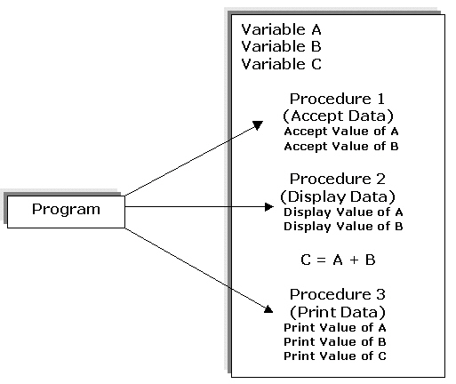
Need for Object-Oriented Programming(Contd.)
Java Fundamentals

Slide 5
Need for Object-Oriented Programming(Contd.)
      Procedural programming is used for developing simple applications.
      The procedural programming methodology has various benefits over the simple sequential programming:
        Easy to read program code.
        Easy maintainable program code as various procedures can be debugged in isolation.”
        Code is more flexible as you can change a specific procedure that gets implemented across the program.
Java Fundamentals

Slide 6
Need for Object-Oriented Programming(Contd.)
      The features of procedural programming methodology are:
        Large programs are divided into smaller programs.
        Most of the data is shared as global that can be accessed from anywhere within the program.
Java Fundamentals

Slide 7
Need for Object-Oriented Programming(Contd.)
      Object-oriented Programming :
        A large application consists of component objects, which interact with each other.
        Can be used to develop various applications.
Java Fundamentals

Slide 8
Object-Oriented Programming
  Advantages of Object-Oriented Programming:
    Real-world programming
    Reusability of code
    Modularity of code
    Resilience to change
    Information hiding
Java Fundamentals

Slide 9
Object-Oriented Programming
    Real-world programming
      The object-oriented approach models the real world more accurately than the conventional, procedural approach.
    Reusability of code
      In the object-oriented approach, you build classes, which can be used by several applications.
    Modularity of code
      An object can be maintained independently of other objects.
    Resilience to change
      Object-oriented programming also enables you to evolve various versions of software.
      When a change is suggested, the old system need not be completely abandoned and re-built from scratch.
    Information hiding
      Information hiding ensures data security in a program.
Java Fundamentals

Slide 10
Object-Oriented Programming(Contd.)
  Identifying the Applications of Object-Oriented Programming:
    Character User Interface (CUI) based Applications
      CUI is an interface used to interact with a computer by typing commands on the command-line.
      CUI is not user-friendly because a user needs to remember all the commands and the syntax of the commands.
    C++ for GUI applications
      Enables you to create GUI applications.
    Graphical User Interface (GUI) based Applications
      GUI is a method of interacting with a computer by directly manipulating graphical images in addition to text.
    Computer Aided Designing/Manufacturing (CAD/CAM)
      Concept of OOP is used to create graphical and numerical building blocks that can be assembled to form portable, flexible, and cost effective solutions for various real life problems.
Java Fundamentals

Slide 11
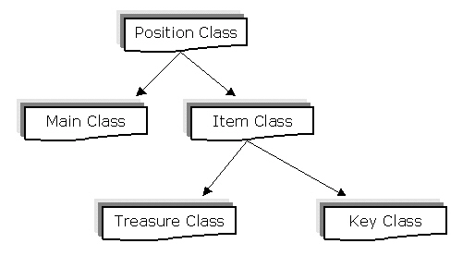
Object-Oriented Programming(Contd.)
    Games
      All the adventure games, sports games, and the space games are modeling some type of objects present in the real world.
      You can organize a game into a collection of "things,” when you apply OOP techniques to the design.
Java Fundamentals

Slide 12
Object-Oriented Programming(Contd.)
  Classes and Objects
    Objects are the basic building blocks of Object Oriented Programming (OOP).
    Characteristics of Objects are:
      State
      Behavior
      Identity
Java Fundamentals

Slide 13
Summary
In this lesson, you learned:
    An object is a software package consisting of variables and methods.
    Various programming methodologies that can be used are:
      Procedural programming
      Object-oriented programming.
    The procedural programming methodology involves dividing a large program into a set of subprocedures or subprograms that perform specific tasks.
    The procedural programming methodology allows code reusability in large applications.
    An object is defined as an instance of a class.
    In the object-oriented approach, classes are designed such that they can be reused.
    The areas of application of the object-oriented programming include CUI, GUI, Games, and CAD/CAM-based programs.
    Object oriented programming offers features such as Reusability, Resilience, Modularity, and Information hiding.
Java Fundamentals

